Slide 1

Definition : Network security refers to the practice of securing a computer network infrastructure against unauthorized access, attacks, and data breaches
Types of Network Security:
Physical Security: Protecting hardware and infrastructure.
Cybersecurity: Safeguarding against digital threats, malware, and cyber attacks.
Access Control: Regulating user access to networks and resources.

Slide 2
Why do we need network security
bad guy listens to the communication
INTERNET
sensitive data
email
Name: ALICE JACK Address: 1 BALL STR Phone Number: 888-9191
DOB: 01/21/1993
SSN: 999-111-2323
Credit Card No:. 9988 5321 Medical Records, Test scores
School Nurse
Notes:
Can you think of sensitive types of data that an attacker or bad guy may like to see? Bank accounts etc

Slide 3
Cryptography
Cryptography
The process of converting a message into a secret code called CIPHER TEXT, and changing the encoded message back to regular text called PLAIN TEXT.
(1) Encryption
The conversion of the original message into a secret code or CIPHER TEXT using a key.
(2) Decryption
The conversion of the encoded message or PLAIN TEXT back to the original message using the same key.

Slide 4


Its All About Keys !!!
My name is Alice Jack.
Encryption
Wi xkwo sc kvsmo tkmu
cypher text
Plain text
key
key
Wi xkwo sc kvsmo tkmu
Decryption
My name is Alice Jack.
Notes:
Talk about car keys, padlock keys, house keys, password keys….. What happens if the bad guy gets your keys?

Slide 5
TYPES OF CRYPTOGRAPHIC ALGORITHMS

Slide 6
Traditional Ciphers
substitution cipher: replaces one symbol with another.
- Monoalphabetic cipher
- e.g: Plaintext: HELLO , Ciphertext: KHOOR
Shift Cipher: Use the shift cipher with key = 15 to encrypt the message "HELLO
The cipher text is: WTAAD (each character shifted 15 characters down).
- polyalphabetic cipher
- Plaintext: HELLO, Ciphertext: ABNZF
Transposition Ciphers: there is no substitution of characters; instead, their locations change.
- Plaintext: 2 4 1 3
- Ciphertext: 1 2 3 4

Slide 7
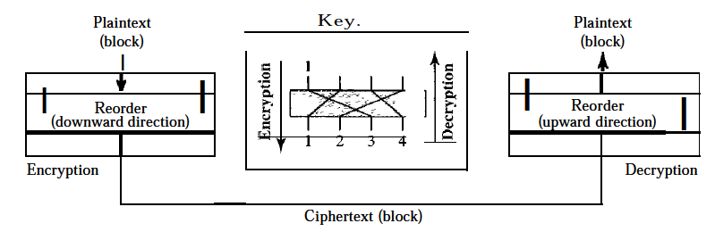
Transposition cipher
- Plaintext: 2 4 1 3
- Ciphertext: 1 2 3 4
e.g: Encrypt the message "HELLO MY DEAR," using the above key
three-block ciphertext ELHLMDOYAZER.
decrypt the message
HELLO MY DEAR

Slide 8
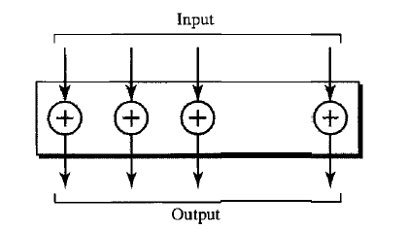
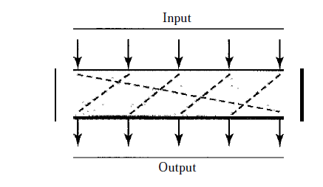
Simple Modern Ciphers
XOR Cipher
one of the inputs is the block to be the encrypted, the other input is a key; the result is the encrypted block.
Rotation Cipher
the input bits are rotated to the left or right.

Slide 9
What is network security?
confidentiality: only sender, intended receiver should “understand” message contents
sender encrypts message
receiver decrypts message
authentication: sender, receiver want to confirm identity of each other
message integrity: sender, receiver want to ensure message not altered (in transit, or afterwards) without detection
access and availability: services must be accessible and available to users

Slide 10
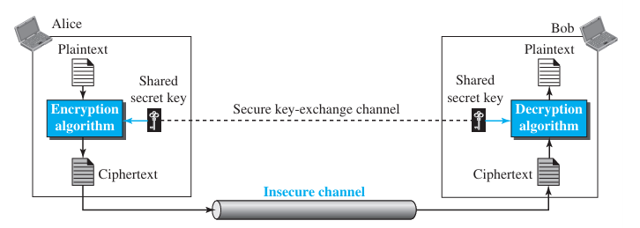

Confidentiality with Symmetric-Key Cryptography

Slide 11
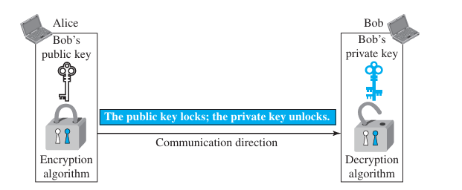
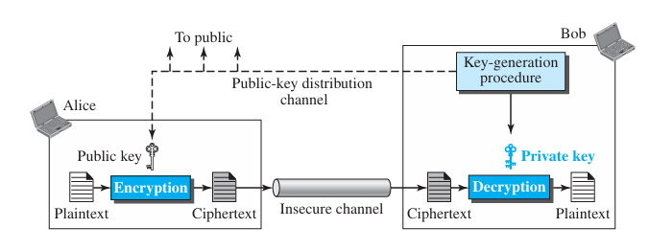
Confidentiality with Asymmetric-Key Cryptography

Slide 12
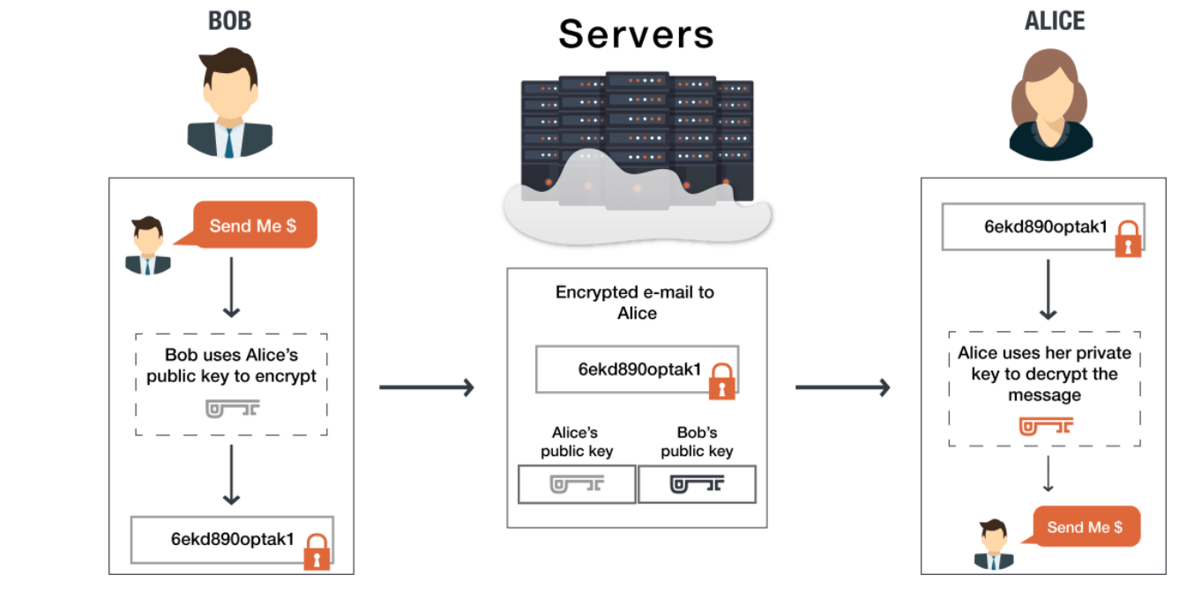
Example: Asymmetric-Key Cryptography

Slide 13

Network Security Protocols
Secure Sockets Layer (SSL)/Transport Layer Security (TLS):
Purpose: Ensures secure data transmission over networks.
Functionality: Encrypts data during transit, preventing unauthorized access.
Application: Commonly used in web browsers for secure connections (HTTPS).
Internet Protocol Security (IPsec):
Purpose: Secures communication at the IP layer.
Functionality: Provides authentication and encryption for IP packets.
Application: Used for VPNs, ensuring secure data transfer between networks.
Secure Shell (SSH):
Purpose: Secure remote access and command execution.
Functionality: Encrypts communication between devices.
Application: Commonly used for remote server administration.
Virtual Private Network (VPN):
Purpose: Establishes a secure, encrypted communication channel over the internet.
Functionality: Protects data during transmission, ensuring privacy.
Application: Enables secure remote access and connections between geographically distant offices.

